Slide 1

International Trade using EGM Neural Networks and Random Forests
Base paper:
Neural Network Analysis of International Trade
Author:
Isaac Wohl Jim Kennedy

Slide 2
Group Members
Prakhar Pradhan 190618 (CE)(Group Leader)
Aditya Gupta 190060 (CE)
Kaushal Chaudhary 190422 (ECO)
Raj Aryan 190673 (CE)
Chirag Sharma 190248 (CE)
Atul Umak 190202 (CE)
Sumit Singh Sheoran 190875 (CE)
Saral Verma 190767 (CE)
Sandeep Gautam 190754 (ECO)
Anurag Yadav 190170 (CE)

Slide 3
Abstract

Slide 4

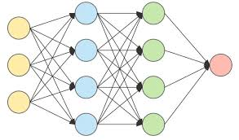
We will examine International Trade Flow from 1948-2018 panel data using both an Intuitive gravity model and the Extended Gravity Model including Multilateral Resistance Terms by using various econometric models like OLS, PPML, NBMPL,GPML, FIXED EFFECT AND NLS and compare it with Neural Network and Random Forest Regression Analysis .We constraint our proposal to the top 18 countries which are as follows: USA, United Arab, Japan, China, Singapore, Hongkong, Belgium, UK, Germany, Korea, France, Saudi Arabia, Bangladesh,Pakistan,Italy,Myanmar, Switzerland and India. We will use databases collected from the IMF, Ministry of Commerce, World Bank , KOF.ethz and CEPII dataset.

Slide 5
Introduction

Slide 6
Gravity Models are the Workhorse of International Trade. A simple Intuitive model includes variables like GDPs of two countries and distance between them. They often include dummy variables that indicate whether the trade partners share a border, a language, a colonial relationship, or a regional trade agreement.
Problem that arises due to intuitive model is let's say how trade is being affected between countries i and j if trade costs change between i and k. This trade diversion and trade creation are such effects which come under multilateral resistance terms which intuitive gravity model does not account for.
Anderson and Van Wincoop(2003) said the Gravity model should also incorporate Multilateral Resistance Terms because relative trade costs matter a lot.
A common way to tackle not just multilateral resistance terms as well as other country specific , cultural terms can be done by using country fixed effects. Some gravity models use country-year fixed effects,country-pair fixed effects or both.
Further Sections include estimation using econometric methods like OLS, Fixed Effect, PPML,GPML,NBPML and compare model’s explanatory powers.
Finally neural network and Random Forest Regression analysis on aggregate trade and further investigation on relative predicting powers of the Different Models.

Slide 7
Literature Review

Slide 8
Wohl and Kennedy in their work examined international trade using neural networks and traditional gravity model approach.their findings showed higher degree of accuracy in prediction using RMSE within the traditional gravity model.
They pointed that the neural network is a highly robust and adaptable model to deal with highly interconnected variables in trade and will be less chaotic.
Anderson and van Wincoop(2003) noted that gravity models should also account for multilateral terms.
Head and mayer(2014) highlighted the importance of fixed effect. By using country specific fixed effects all monadic terms including multilateral terms are captured.

Slide 9
One problem aroused how to deal with zero trade flow?. Santos Silva and Tenreyro came up with Poisson pseudo maximum likelihood (PPML). Yotov(2016) prescribes use of PPML for estimating Gravity equations and it also helps in dealing with heteroscedasticity.
Author measured the accuracy of the out of sample predictions using RMSE(root mean square error). He noted that PPML and neural network estimators RMSE is higher using country year fixed effect than compared to country fixed effect.
They trained the neural network on the full dataset with country fixed effects from 1986-2006 and used it to predict trade between the USA and its major trading partners between 2007-2016.

Slide 10
Objective

Slide 11
We will apply both intuitive and extended gravity models including multilateral resistance terms on panel data from 1948-2019 specifically including top 18 countries.
We will apply various econometric methods like OLS, PPML, fixed effect model, NBPML,GPML and NLS and compare their model’s explanatory powers.
We will compare intuitive gravity model with extended gravity model by comparing R square value.we will also apply Fixed effect estimation that incorporates Multilateral terms.
We will also apply PPML, GPML,NBPML and NLS and see their explanatory Powers.
We will train neural networks and Random Forest Regression Analysis on a dataset and compare its predicting power to gravity ones using R square value.

Slide 12
Hypothesis

Slide 13
Intuitive gravity model only considers variables like GDP, distances and other dummy variables excluding the multilateral resistance terms. We wish to see that estimation using that is giving bad results as trade cost matters and the basic model does not include that.
Extended gravity model does take multilateral terms into account which can be estimated using either through fixed effect model or the use of taylor series approximation of multilateral terms introduced by baier and bergstrand(2009) without inclusion of two dummy variables.it also helps in dealing with endogeneity.
We wish to use PPML model as well as it helps in dealing with zero trade flow developed by silva and Tenreyro(2006).
We also wish to use an extended version of PPML which is GPML which is an iterative approach and more robust. PPML is more robust than OLS and more preferred nowadays.
Neural network and Random Forest Regression Analysis R square value are far better than Gravity ones.

Slide 14
Model and Methodology

Slide 15
Writing gravity model in its Basic Form:
(GDP_{i})^{𝝱1} (GDP_{j})^{𝝱2}
T_{ij} = ɑ __________________________________
(D_{ij})^{𝝱3}
Writing gravity model as OLS estimators:
lnX_{ij,t} = θ₀ + θ₁ln(GDP_{i,t}) + θ₂ln(GDP_{j,t}) + θ₃ln(Dist_{ij}) + θ₄Contig_{ij} + θ₅Comlang_{ij}+ θ₆Col_{ij} + θ₇ln(Infra_{i}) + θ₈ln(Infra_{j})+ θ₉Obor_{ij} + θ₁₀Asean_{ij} + θ₁₁Eac_{ij} + θ₁₂Sadc_{ij} + e_{ijt}
Adding some fixed country effects:
lnX_{ij,t} = θ₀ + θ₁ln(GDP_{i,t}) + θ₂ln(GDP_{j,t}) + θ₃ln(Dist_{ij}) + θ₄Contig_{ij} + θ₅Comlang_{ij}+ θ₆Col_{ij} + θ₇ln(Infra_{i}) + θ₈ln(Infra_{j})+ θ₉Obor_{ij} + θ₁₀Asean_{ij} + θ₁₁Eac_{ij} + θ₁₂Sadc_{ij} + 𝜇_{i} + ɑ_{j} +e_{ijt}
Alternatively, with country year fixed effects:
lnX_{ij,t} = θ₀ + θ₁ln(GDP_{i,t}) + θ₂ln(GDP_{j,t}) + θ₃ln(Dist_{ij}) + θ₄Contig_{ij} + θ₅Comlang_{ij}+ θ₆Col_{ij} + θ₇ln(Infra_{i}) + θ₈ln(Infra_{j})+ θ₉Obor_{ij} + θ₁₀Asean_{ij} + θ₁₁Eac_{ij} + θ₁₂Sadc_{ij} + 𝜇_{it} + ɑ_{jt} +e_{ijt}

Slide 16
Y = f(w₁x₁ + w₂x₂ + b)
There are different types of Activation function in the literature defined as follows:
sigmoid(x) = 1/(1 + exp(−x))
tanh(x) = 2*sigmoid(2x) − 1
ReLU(x) = max(0, x)
Random Forest Regression
Supervised learning model which prevents Overfitting of the data. It uses multiple decision Trees which increases accuracy
f_{rf}^{B}(x) = (1/B)*(∑^{B}_{b=1}T_{b}(x))
Var((1/B)*(∑^{B}_{b=1}T_{b}(x))) = 𝜌𝜎² + 𝜎²((1 - 𝜌)/B)
Here B is the number of trees.
Tb = Random Forest Tree

Slide 17
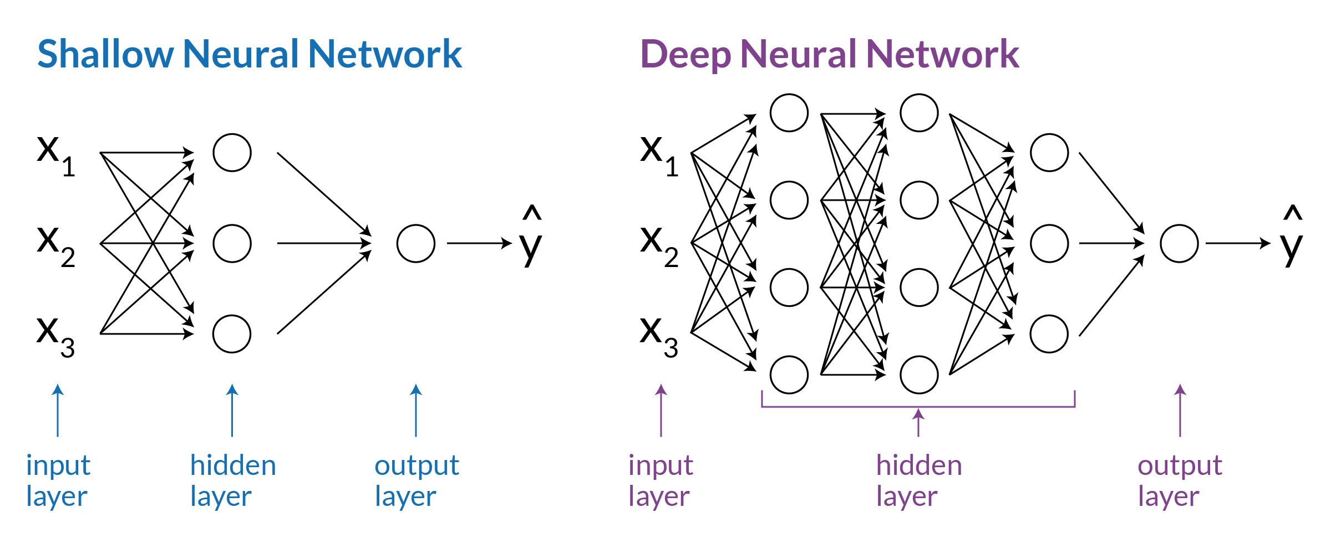
Depiction of ANN

Slide 18
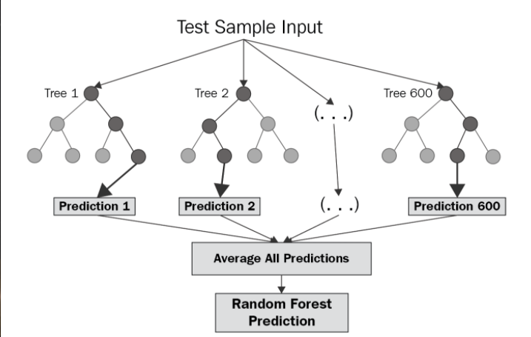
Random Forest Regression

Slide 19
Variable Description

Slide 20
Variables | Description
Tradeflow_comrade_o | Trade flow as reported by the exporter (in thousands current US$) (source: Comtrade)
iso3 | ISO3 alphabetic code
Country | Country name
Contig | Dummy equal to 1 if countries are contiguous
Distw | Population-weighted distance between most populated cities (km)
Distwces | Population-weighted distance between most populated cities (km) using CES formulation with θ = −1
Comlang_off | 1 if countries share common official or primary language
Comlang_ethno | 1 if countries share a common language spoken by at least 9% of the population

Slide 21
Variables | Description
Comcol | 1 if countries share a common colonizer post 1945
Comrelig | Religious proximity index
Pop | Population (in thousands)
Gdpcap | GDP per capita (current thousands US$)
Comcur | 1 if pair currently shares the same currency
Gatt | 1 if country currently is a GATT member
wto | 1 if country currently is a WTO member
rta | 1 if the pair currently has a RTA (source: WTO)
Rta_coverage | Indicates whether the RTA covers goods only or goods and services (source: WTO)
Rta_type | Indicates the type of RTA (customs union for instance)

Slide 22
Datasets Preview
Extracted from various sources such as World Bank , Ministry of Commerce, KOF, CEPII and IMF.

Slide 23
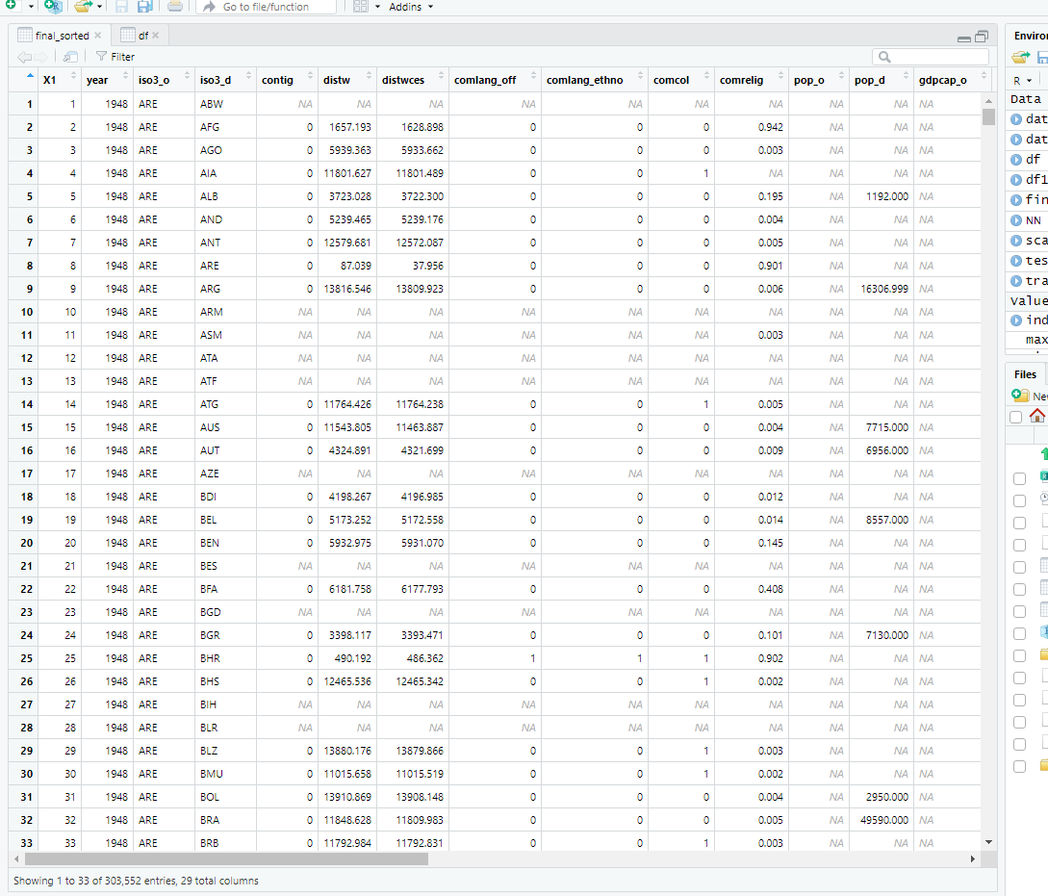
Top 18 countries including India.
Total Entries 303552 and 29 columns

Slide 24
CODES

Slide 25
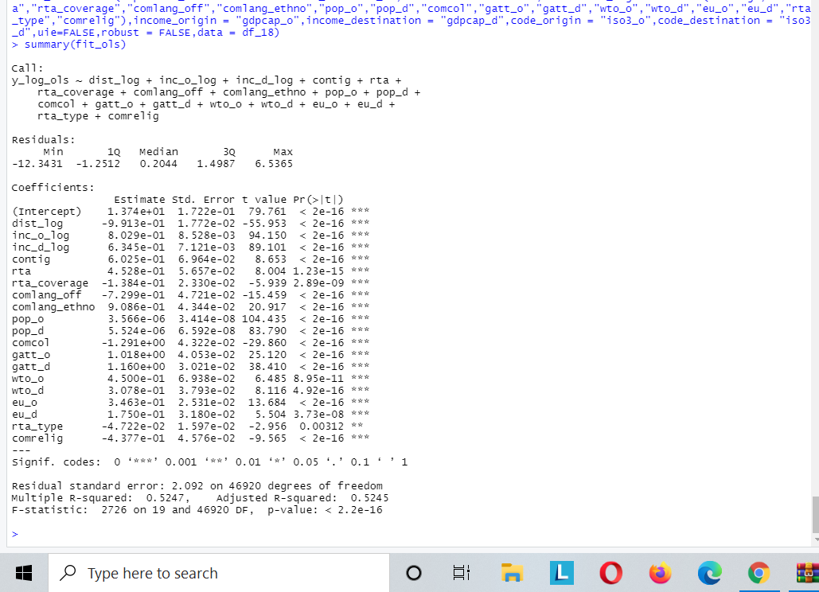
OLS estimation using Gravity Package.
R square Value Observed is 0.52
And you can see P value are significant upto 10 percent

Slide 26
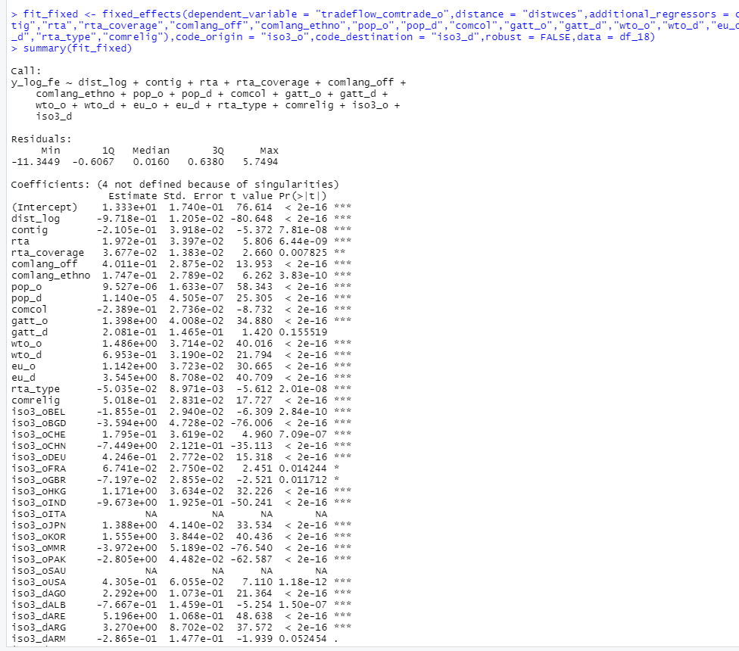
Fixed effect estimation.

Slide 27
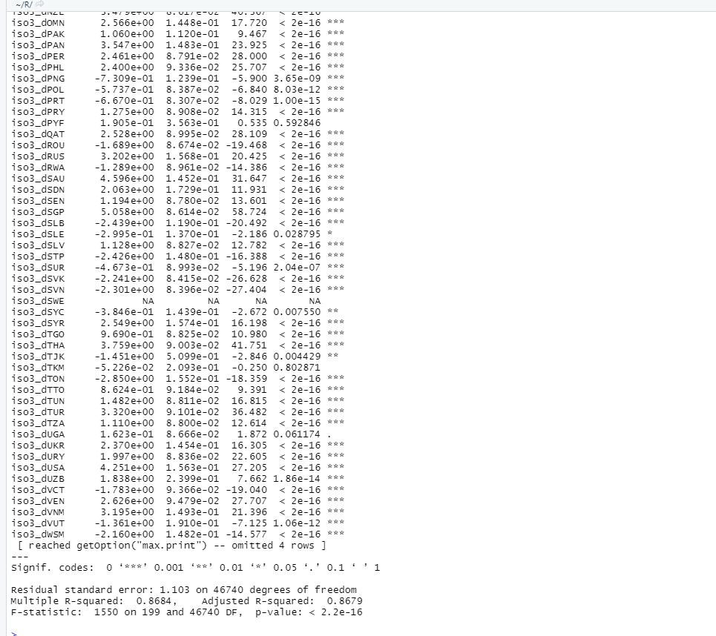
R square is 0.86
Better than ols considering Multilateral terms

Slide 28
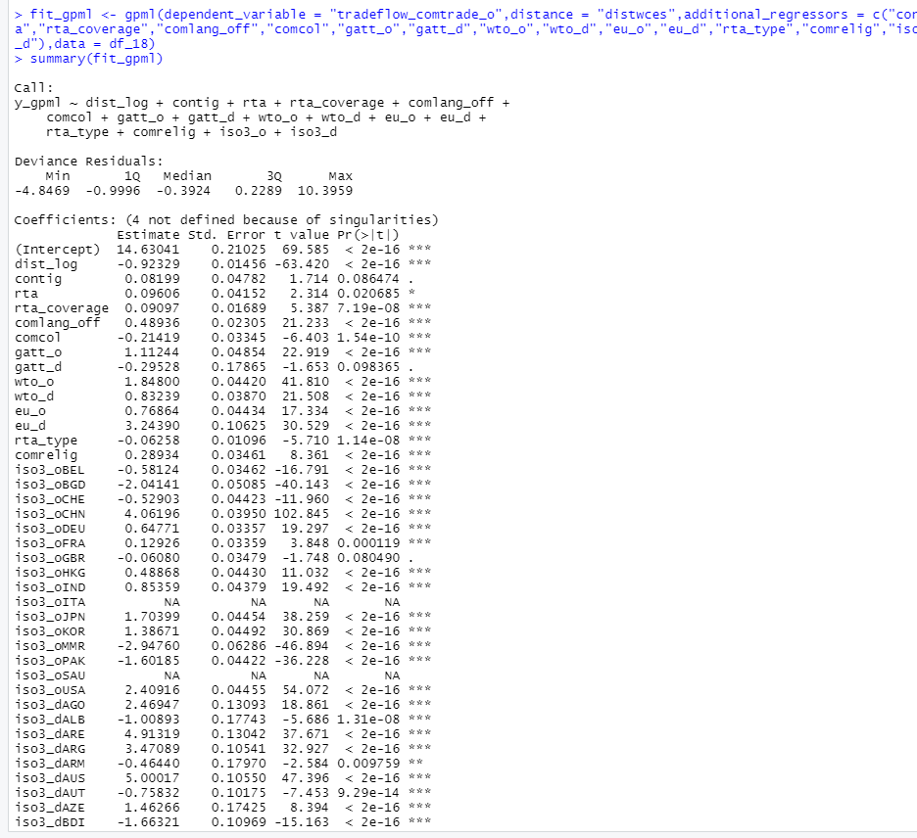
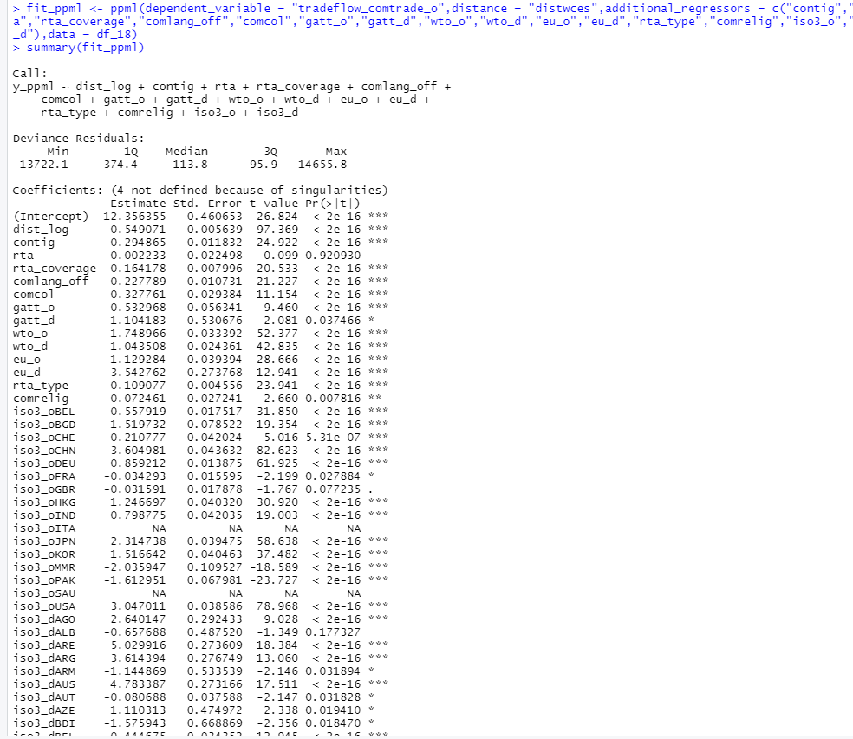
GPML estimation
PPML estimation

Slide 29
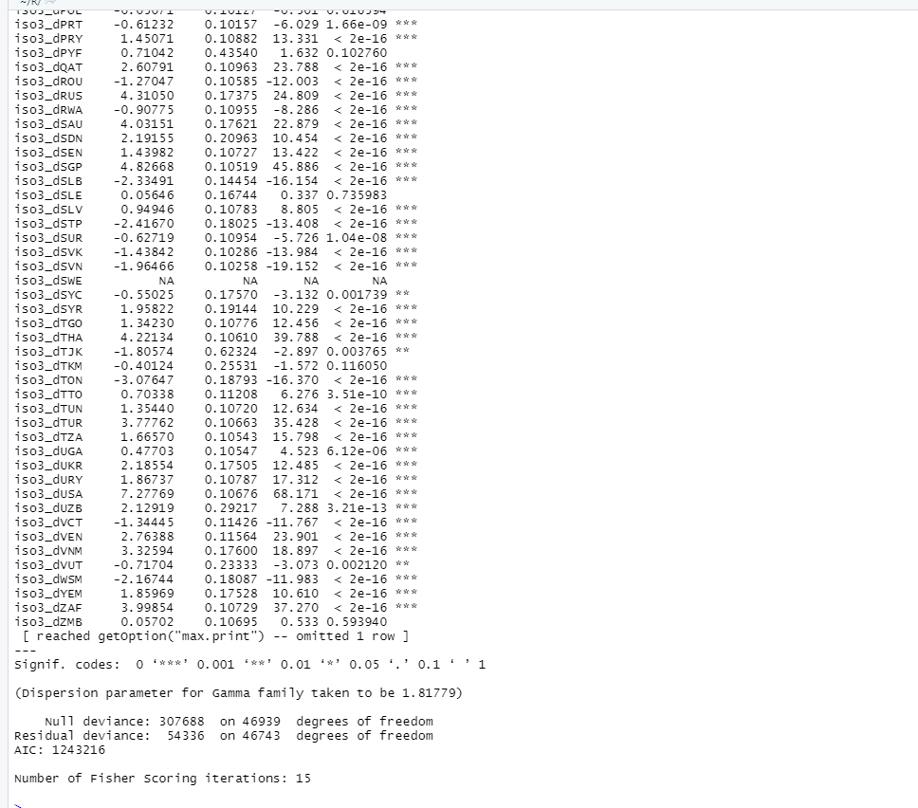
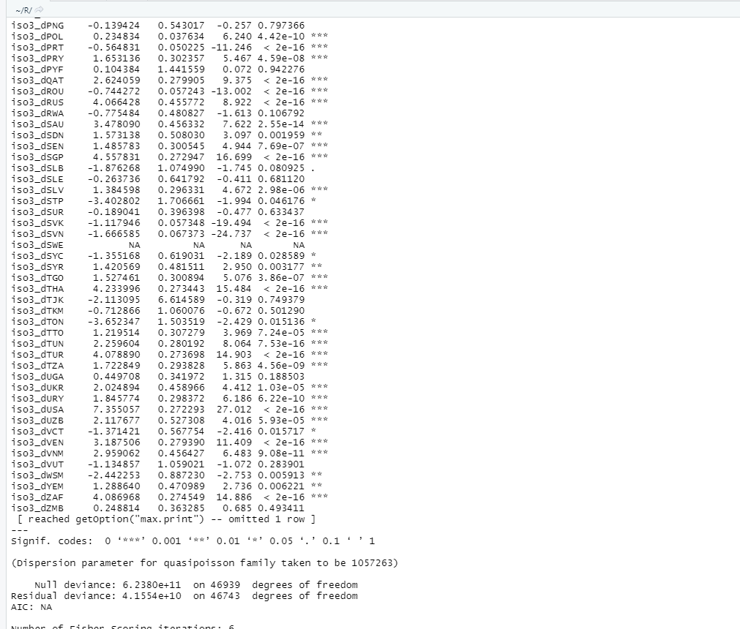
Continued GPML
Continued PPML estimation

Slide 30
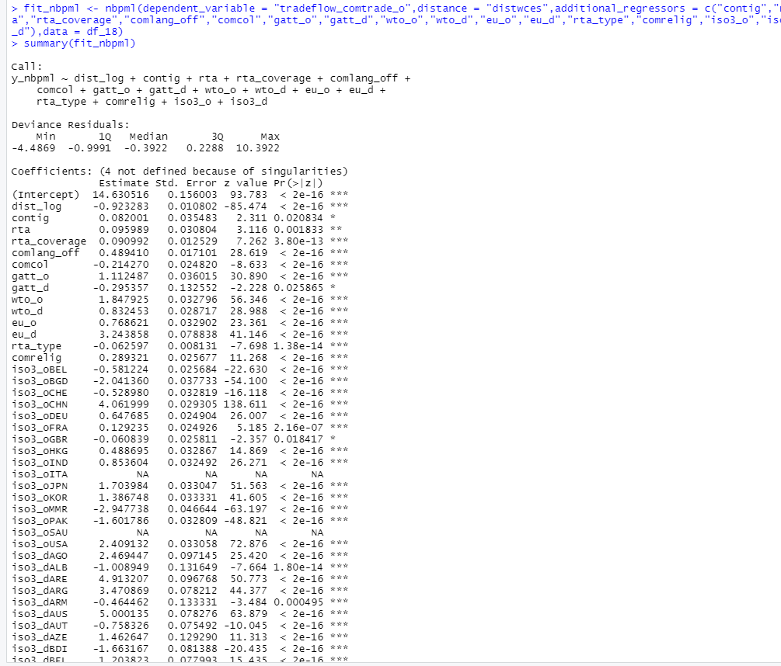
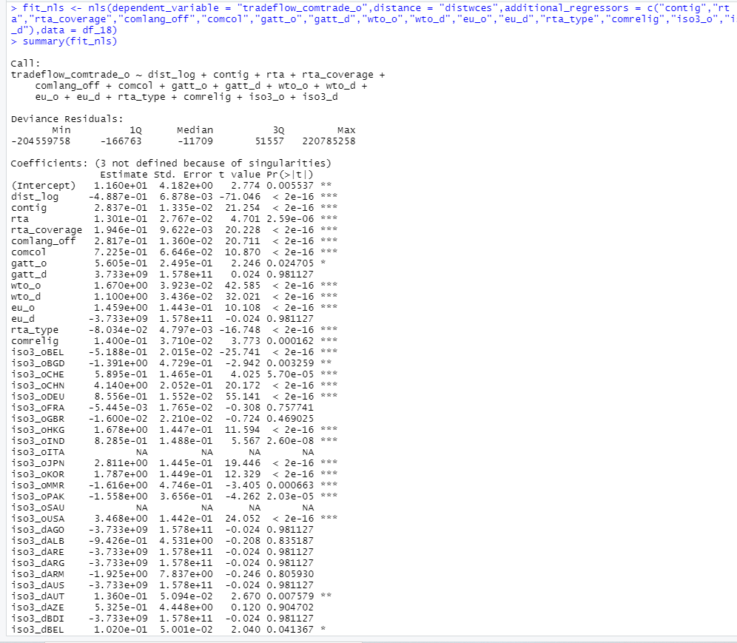
NBPML estimation
NLS estimation

Slide 31
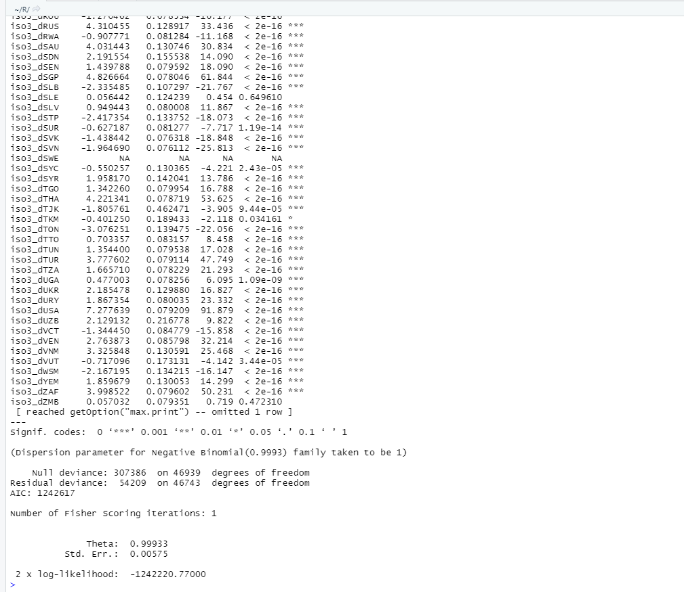
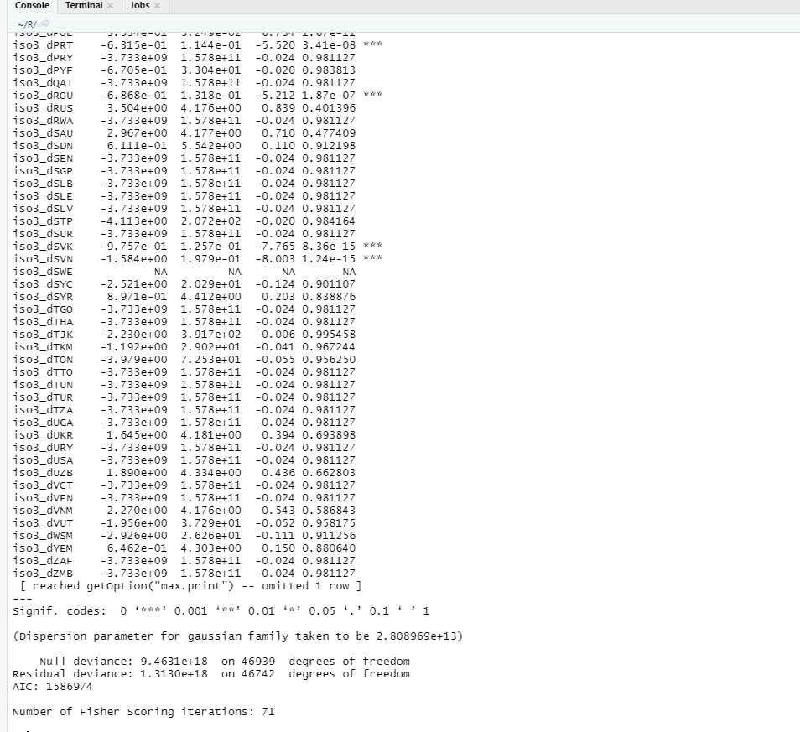
Continued NBPML estimation
Continued NLS estimation

Slide 32
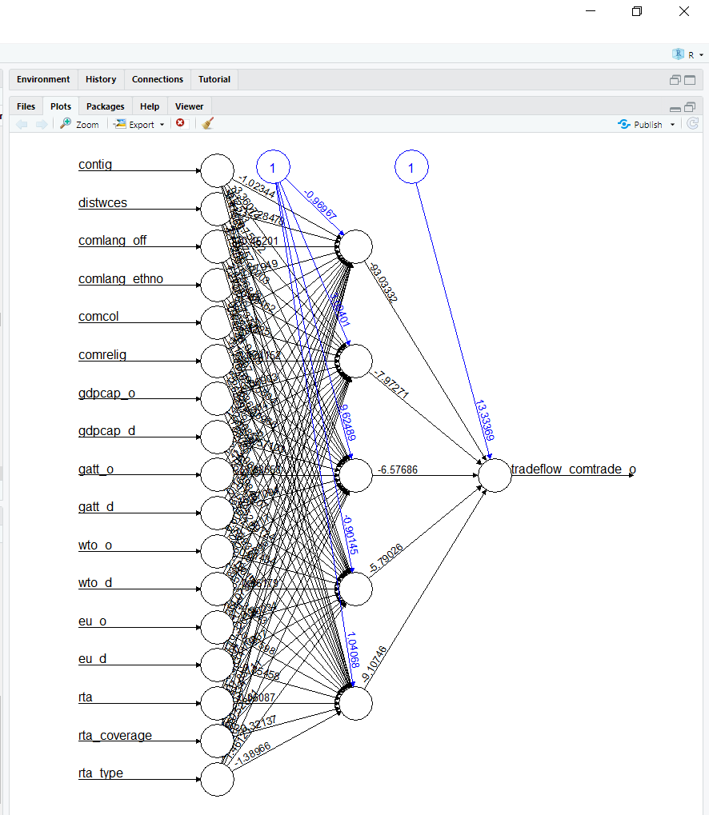
Neural Network we performed this excluding the multilateral terms.
Hidden layer -5
Algorithm : “Rprop”
Learning rate = 0.1

Slide 33
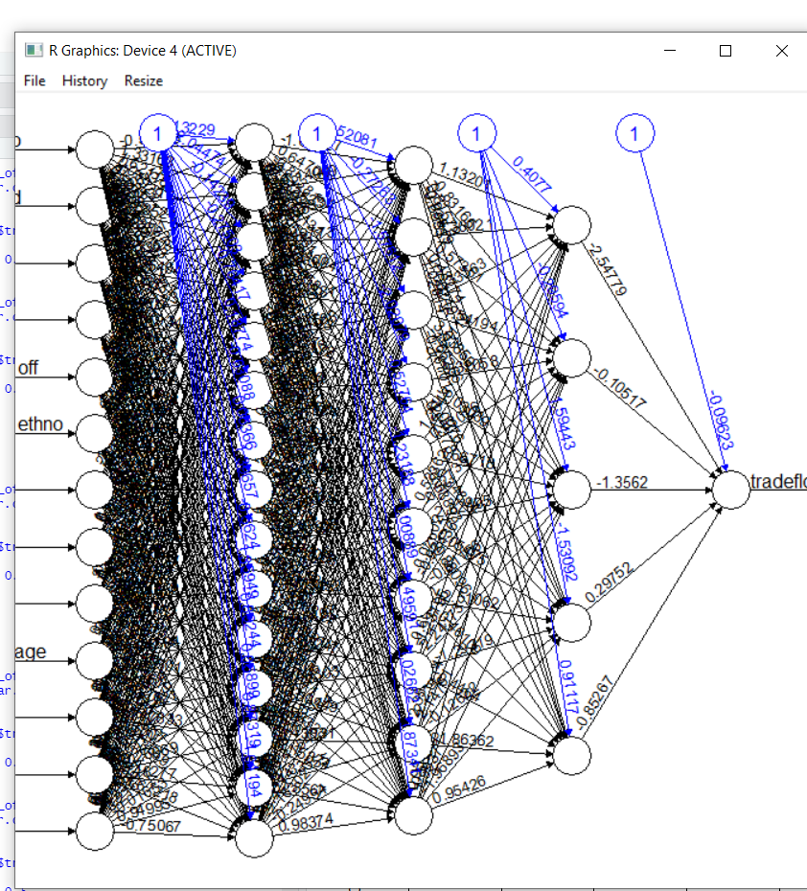
More Dense Network
Hidden Layer :- c(15,10,5)
Algorithm :- rprop+
Learning rate :- 0.01

Slide 34
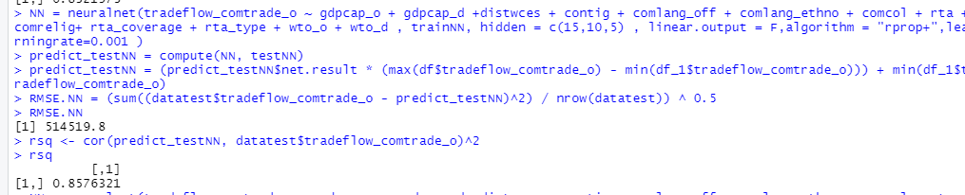
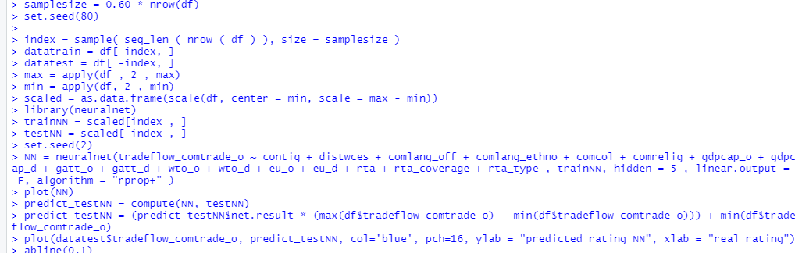
R sq value is 0.857 which clearly states that neural network is far more better than intuitive Gravity model
Note: we have not considered Multilateral terms in neural network analysis.
R code for Neural net using neural net package

Slide 35
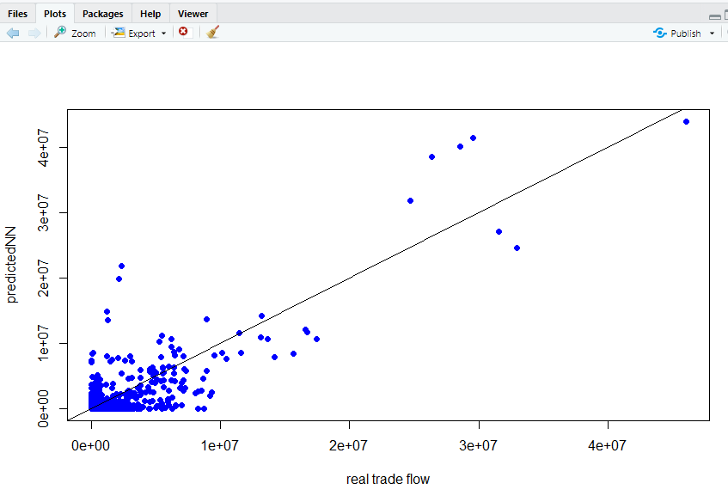
A line clearly fits the data.

Slide 36
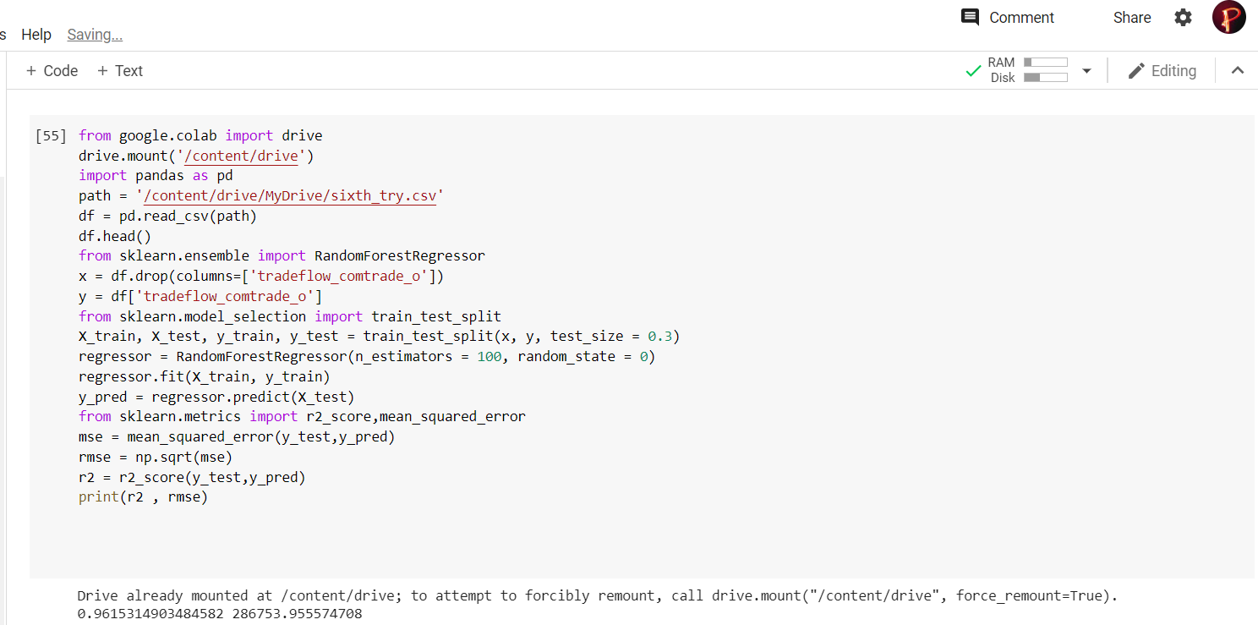
R square Value :- 0.96 . Far Better than Both Intuitive and Extended model.
Moreover better than Neural Network as well.

Slide 37
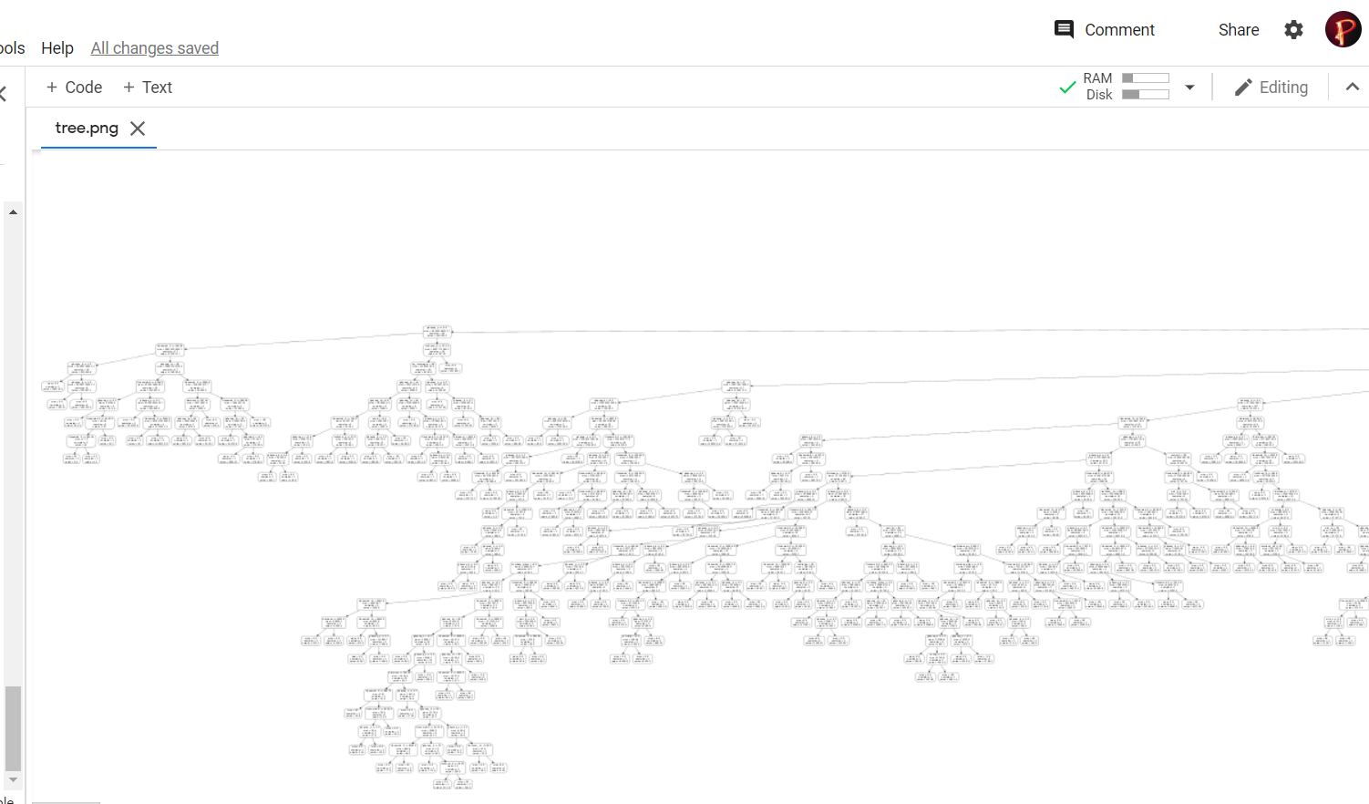
Depiction of the Tree

Slide 38
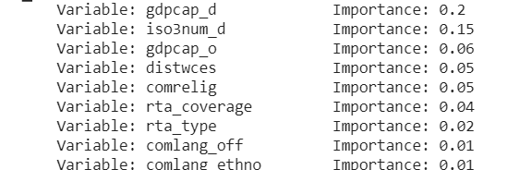
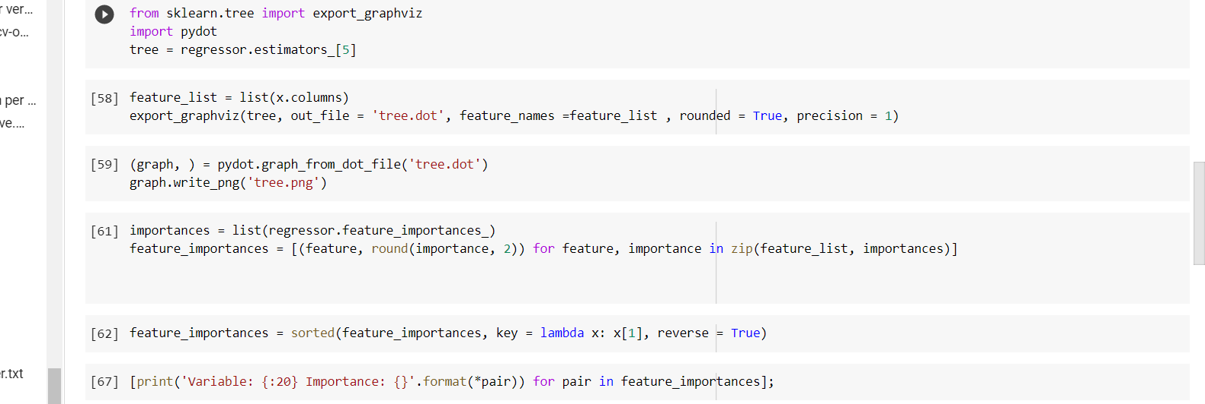
Variable Importance Table
Further Code
Of Random Forest Regression

Slide 39
Tentative Conclusion

Slide 40
Neural networks have a high degree of accuracy in prediction compared to R-Square within the Gravity model.
Model’s explanatory power increased by using the Fixed effect model and it clearly underlines the importance of multilateral resistance terms.
PPML is more preferred to Other econometric methods.
Neural network RMSE is much lower than gravity ones which clearly indicates that in future we should move onto use the machine learning models for estimating international trade patterns as it helps in dealing with large datasets which have numerous interconnected variables
We saw that Intuitive Gravity Model is basic one which has R square value of 0.52. By applying fixed effect including multilateral terms we got to see R square value increased to 0.86.
We also applied new methods like PPML,NBPML,GPML and saw their results.
Finally we applied neural network and Random Forest Regression and we saw R square value to be more than intuitive Gravity Model which clearly states model is better.

Slide 41
References
Base Paper: Neural Network Analysis of International Trade
Isaac Wohl and JIm Kennedy: Neural Network Analysis of International Trade
Bhattacharyya, R., Banerjee, T., 2006. Does the gravity model explain India’s direction of trade? A panel data approach. Working Paper No. 2006-09-01, Indian Institute of Management, Ahmadabad.
Anderson, J.E., 2011. The Gravity Model. Annual Review of Economics 3(1), 133-160.
Bhattacharya, S. K., 2004. Does Bangladesh benefit from preferential trade with India? a gravity analysis. Economic and Political Weekly 39 (48), 5152-5162.
Yotov, Y.V. A simple solution to the distance puzzle in international trade. Econ. Lett. 2012, 117, 794–798
Anderson, James and Eric van Wincoop. “Gravity with Gravitas: A Solution to the Border Puzzle.” American Economic Review, vol. 93, no. 1, March
Head, Keith and Thierry Mayer. “Gravity Equations: Workhorse, Toolkit, and Cookbook.” CEPII Working Paper, September 2013
Anderson, J. 1979. “A Theoretical Foundation for the Gravity Model.” American Economic Review, 69(1): 106-116

Slide 42
Datasets
https://data.imf.org/?sk=9d6028d4-f14a-464c-a2f2-59b2cd424b85&sId=1390030341854
https://data.worldbank.org/
https://commerce.gov.in/
http://www.cepii.fr/cepii/en/bdd_modele/bdd.asp
https://kof.ethz.ch/en/forecasts-and-indicators/indicators/kof-globalisation-index.html

Slide 43
Thank You

